Slide 1
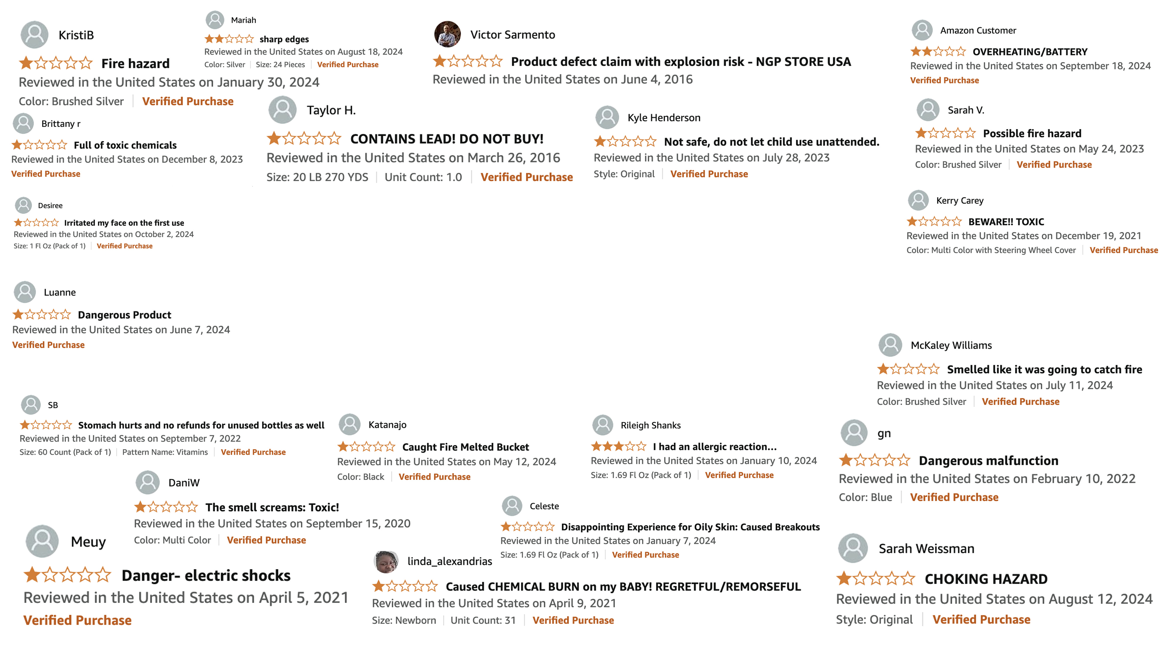

TEAM SAFETY DANCE
PROACTIVE IDENTIFICATION OF PRODUCT SAFETY ISSUES

Slide 2




MEET TEAM SAFETY DANCE
Aakash Boenal
Jonathan King
Utkarsh Ganjihal
Saiphani Vuppala
Scrum Master
Product Owner
Developer
Developer

Slide 3

PROJECT PARTNER
NIRA, INC.
• Dr. Wen Zhu, Chief Architect
• John Oh, .NET Developer
NIRA, Inc. is a woman-owned small business and certified 8(a) firm.
Specializes in Information Technology services for public sector clients.
Works closely with customers throughout the project lifecycle.
Key Clients: Federal agencies like CPSC, FDA, FAA, and DTIC.

Slide 4

Domain of problem:
Retail and product safety across various categories.
Importance of problem:
Unsafe products in the market can lead to serious risks leading to costly recalls and reputational damage for companies.
A proactive approach is essential to avoid these issues.
PROBLEM CONTEXT

Slide 5

PROBLEM STATEMENT
The current recall process not proactive
After products already in tens of thousands of consumers' hands.
Focused on using crowdsourcing, historical recall/incident data, and advanced analytics to identify potential safety risks
Baby products used as approach baseline
Pipeline can be applied to many other product categories
By detecting risks early, aim to reduce defective products reaching too far into the market,
Enhance consumer safety
Minimize impact of recalls

Slide 6


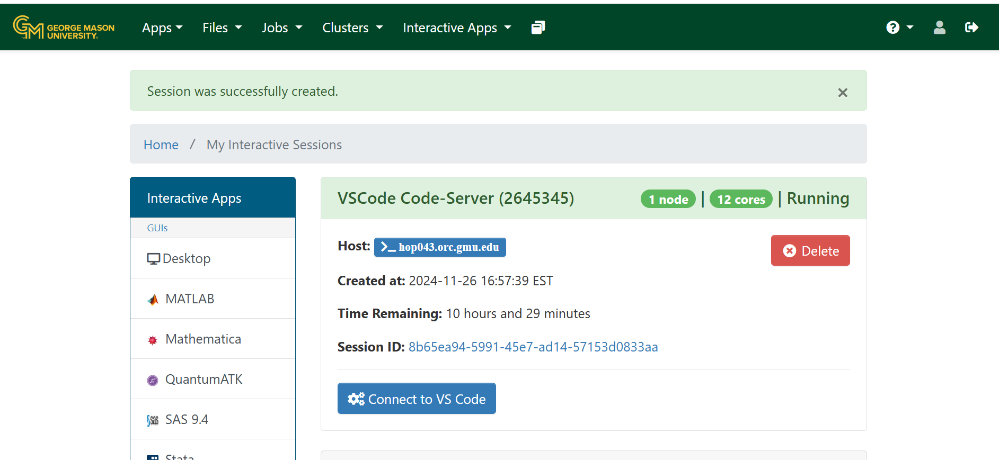
DATASETS
Amazon
Reviews - 6M ~ 2.2 GB (Baby products only)
Metadata - Approximate 217K records ~ 600MB
CPSC
Incidents - Approximate 59K records ~ 84MB​
Recalls - 9100 records ~ 11MB​
​Dataset Location: Internet
Dataset Access:
https://amazon-reviews-2023.github.io/
https://www.saferproducts.gov/SPDB.zip
Storage & Computing: GMU ORC Hopper Cluster
Specification:
Node Type: AMD, Intel
Partition: Interactive, Normal, Contrib, GPU, Contrib GPU, BigMemory
Time limit (in hours): MAX (12 hours)
Number of cores: 1-12
Memory GBs/core: 4-8

Slide 7
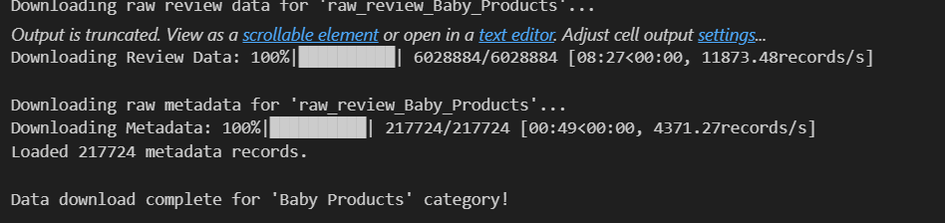
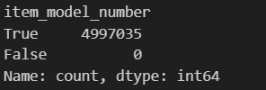
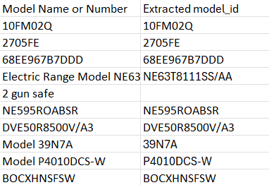
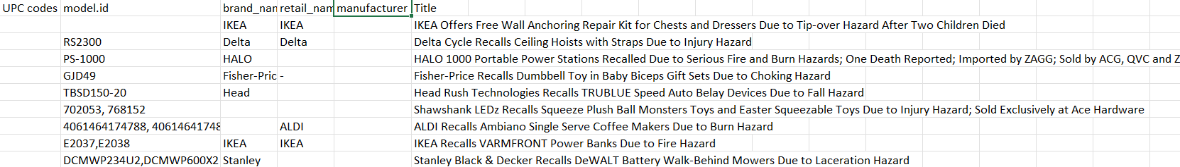
WORKFLOW
Data Cleaning:
Both the incidents and the recalls were cleaned manually which includes:
Extracting model_id, UPC codes, ASIN from the model id column in the Incident dataset.
Extracting model_id, UPC codes, Brand, Manufacturers in the Recall dataset

Slide 8
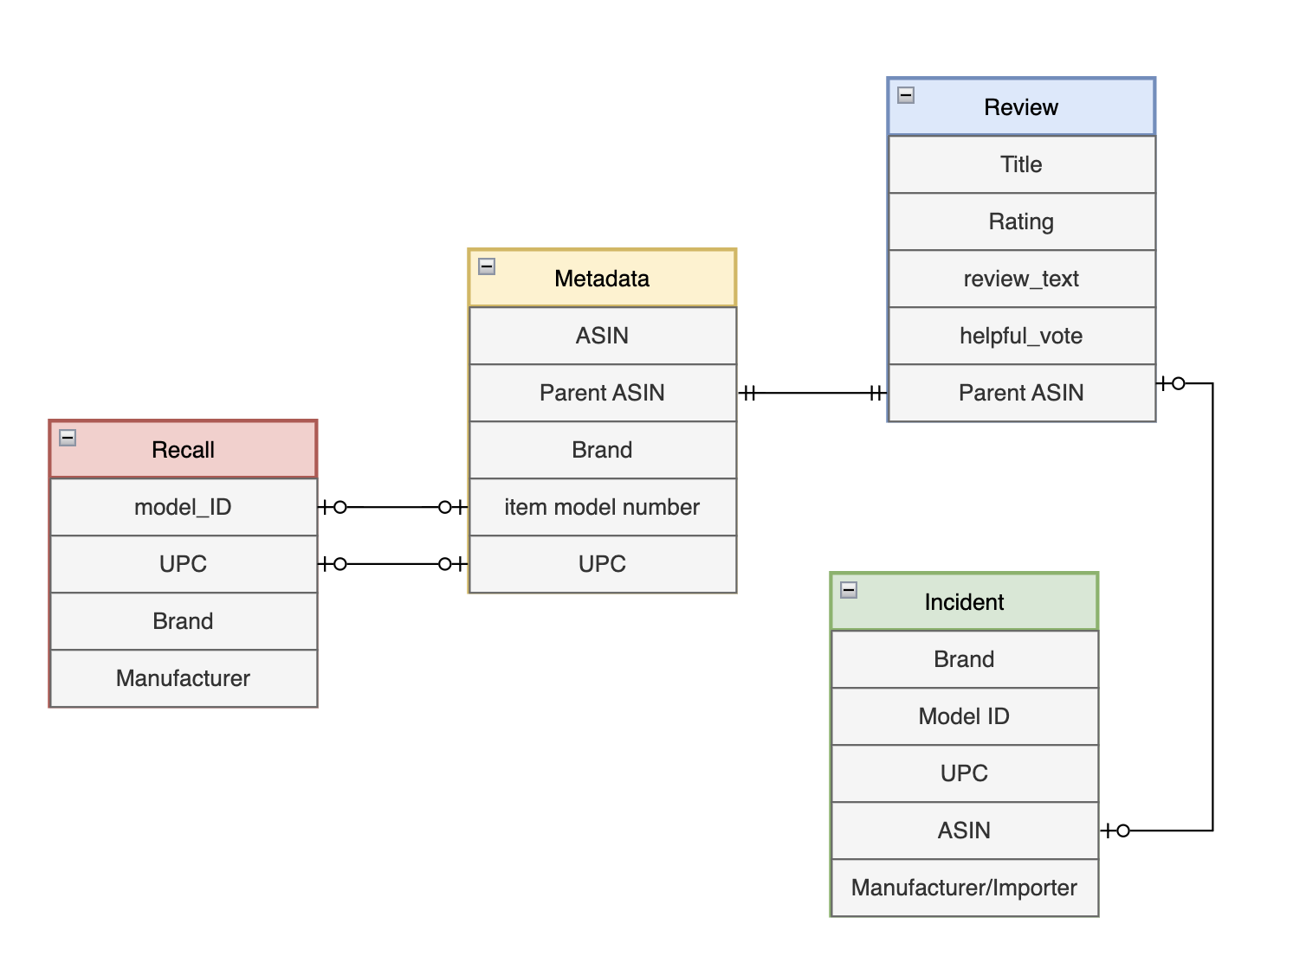
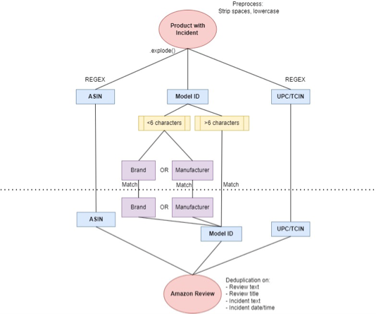
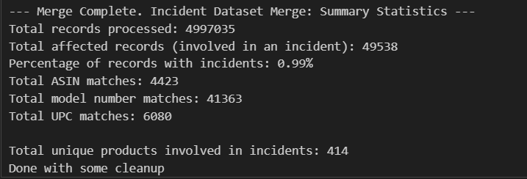
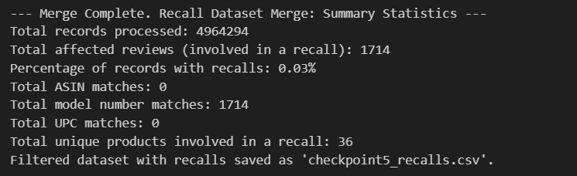
DATA MERGE

Slide 9
SENTIMENT ANALYSIS DISTRIBUTION
01
Conducted Sentiment Analysis on Raw Amazon Reviews dataset
02
Mapped product ratings to sentiment categories (positive, negative, neutral)
Used Vader-Sentiment Analysis model to evaluate the sentiment score of text (text and incident_description) producing a compound score and sentiment
03
04
Modified sentiment scores based on rating categories for finer analysis

Slide 10
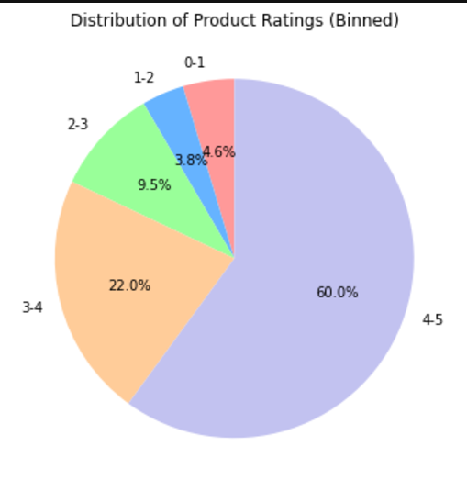
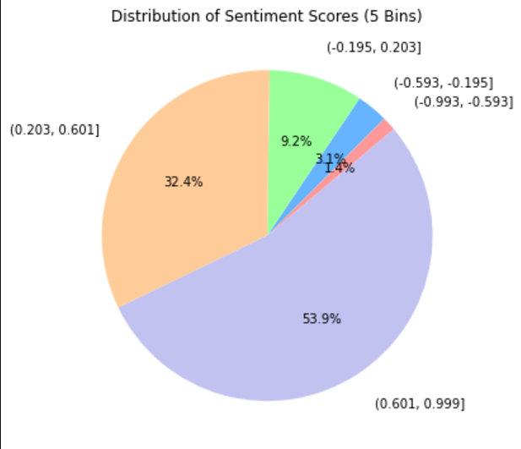
RATING DISTRIBUTION
SENTIMENT ANALYSIS DISTRIBUTION
Fig: Pie chart of Product Ratings Distribution
Fig: Pie Chart of Sentiment Scores grouped into bins
Highlights:
Proportions of 1-star to 5-star ratings,
Comparisons with sentiment analysis
General customer sentiment towards products
Highlight:
Focus points are negative & neutral sentiment.
General polarity scores

Slide 11
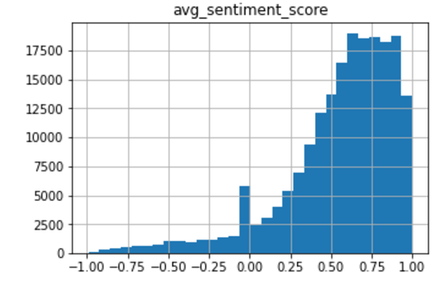
SENTIMENT ANALYSIS VISUALIZATION 2
The histogram shows the distribution of average sentiment scores across all product reviews.
Sentiment score ranges from -1 to 1
The predominance of positive sentiment highlights general satisfaction with the products.
Negative sentiments, although minimal, may correspond to specific product defects or incidents.
Products with frequent negative sentiment scores should be prioritized for further investigation
Fig: Histogram of sentiment scores

Slide 12
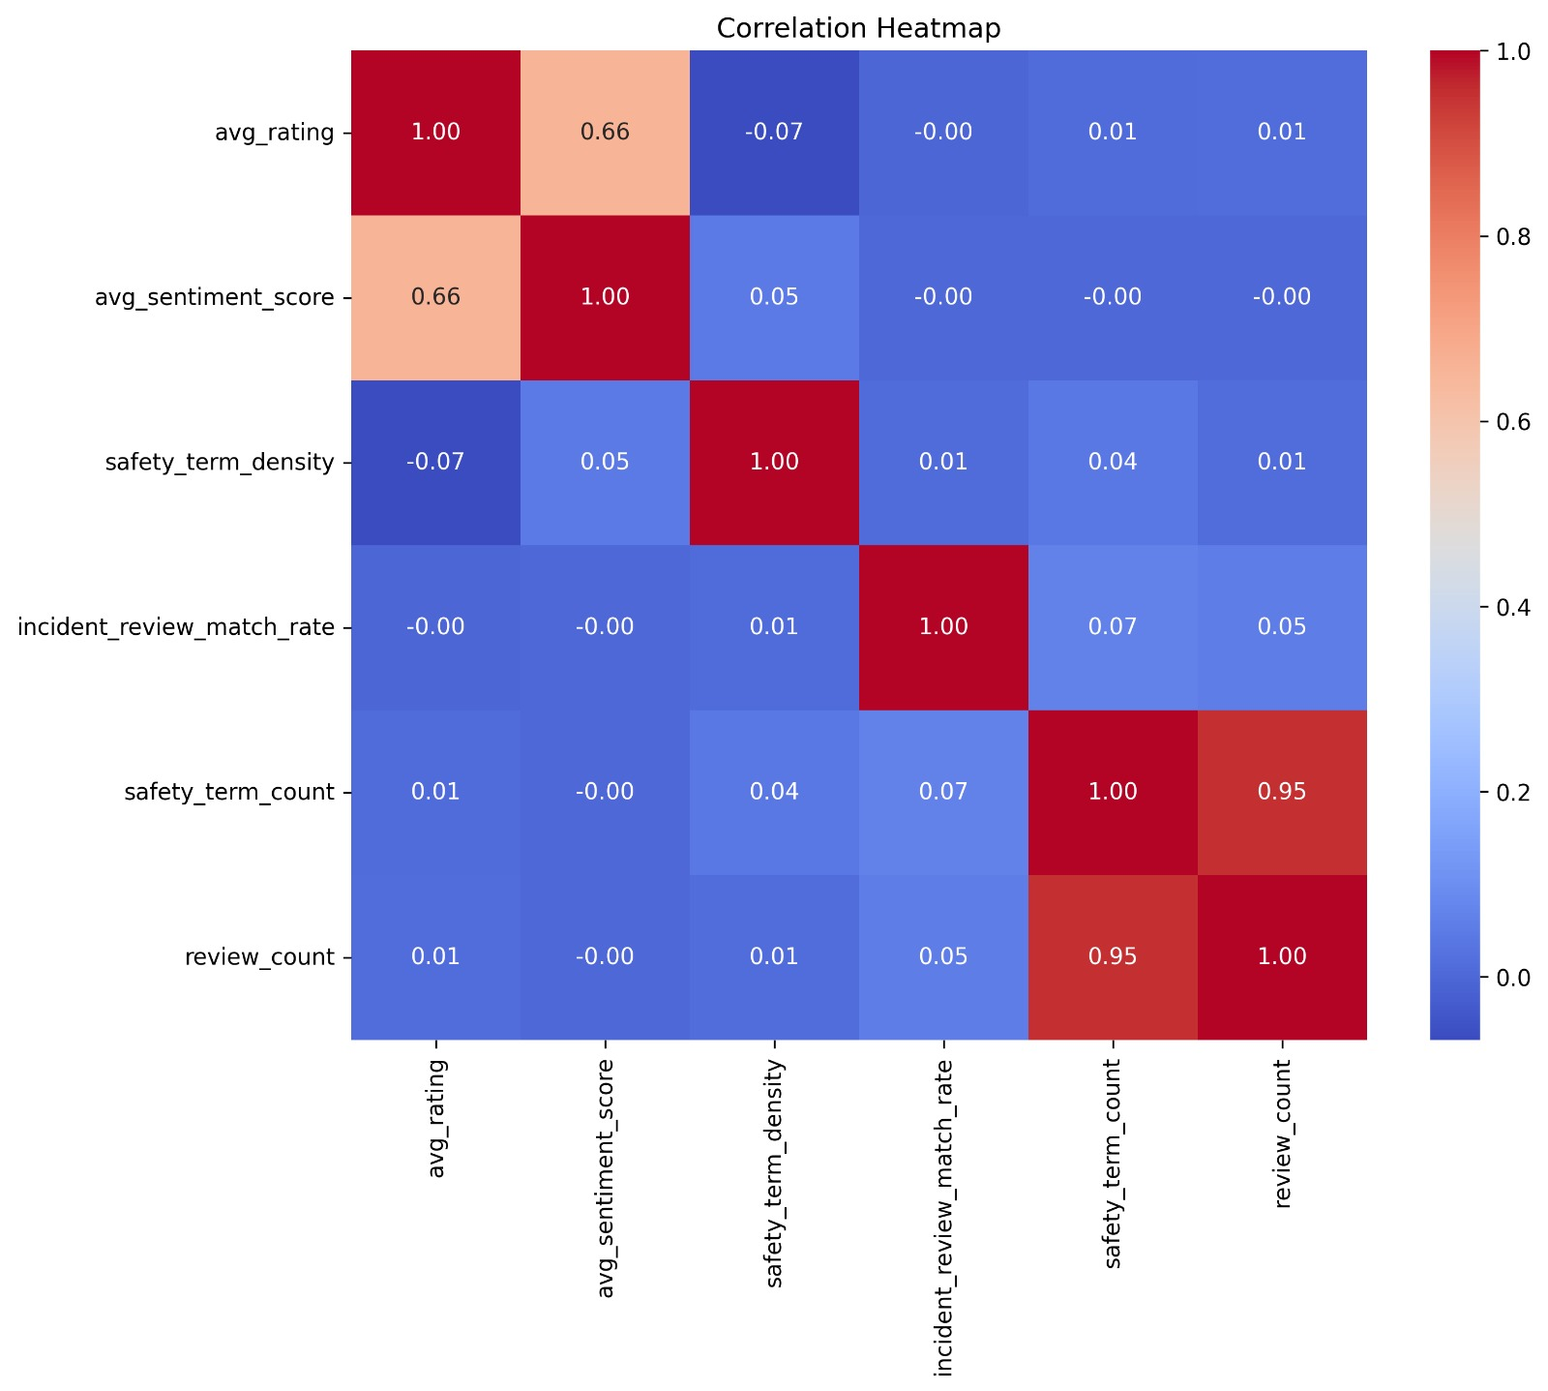
CORRELATION ANALYSIS
Key Observations:
Strong Positive Correlations:
safety_term_count and review_count (0.95): More reviews uncover more safety-related terms.
avg_rating and avg_sentiment_score (0.66): Positive sentiment aligns with higher ratings.
Weak Correlations:
avg_rating and safety_term_density (-0.07): Safety term density has minimal impact on ratings.
avg_sentiment_score and incident_review_match_rate (-0.00): No significant relationship observed.
Fig: Heatmap of Correlation Analysis

Slide 13
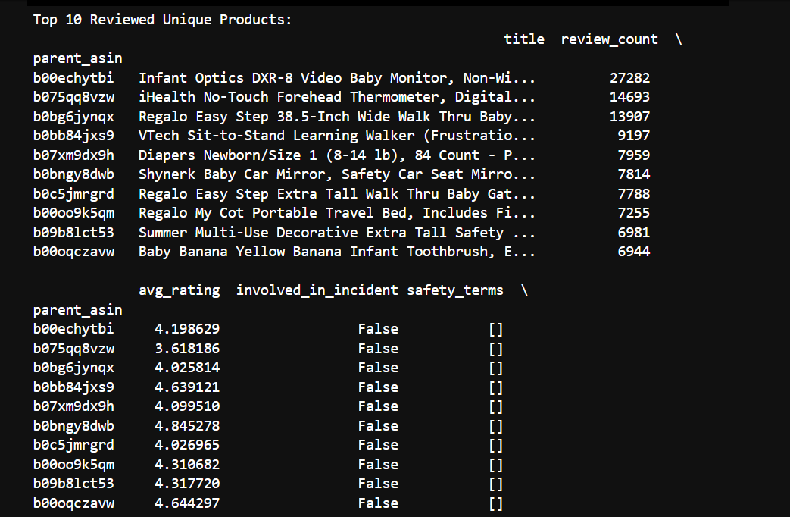
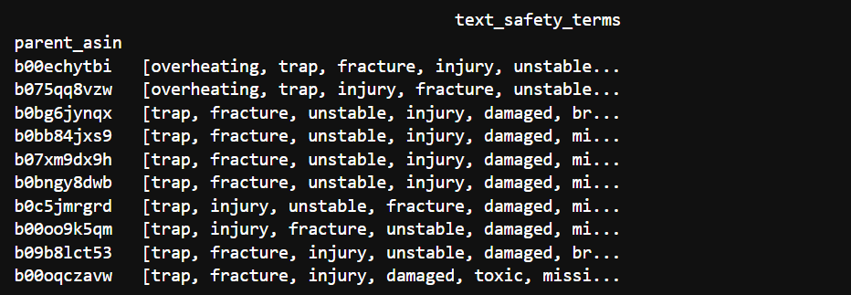
TOP 10 REVIEWED PRODUCTS
Visualization: Table of top 10 products by review count and rating
Columns: Product title, review count, average rating, involvement in incidents, safety terms.
Key Insight: "High-review products generally have high ratings, but some are linked to incidents."

Slide 14
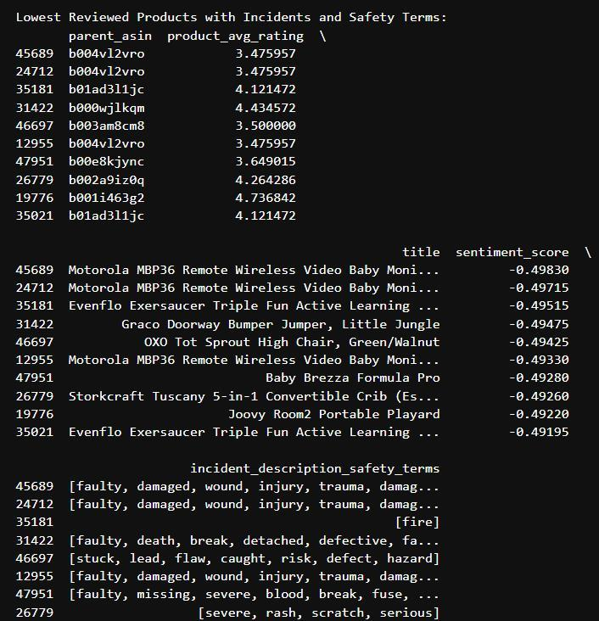
IDENTIFYING RISKY PRODUCTS
Visualization:
Table of the lowest-rated products with incidents and safety terms.
Columns:
Product title, review count, average rating, safety-related terms.
Key Insights:
"Products with low ratings and high safety terms indicate areas of concern."

Slide 15
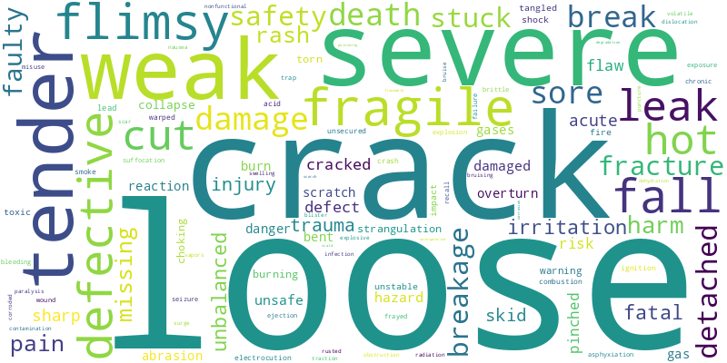
SAFETY WORD ANALYSIS
Key Takeaways:
Frequent terms reveal common safety concerns, such as:
Structural issues (e.g., loose parts, cracks).
Critical incidents (e.g., severe injuries, hot surfaces).
Insights guide quality control and risk mitigation efforts.
Fig: Word Cloud for Safety Terms

Slide 16
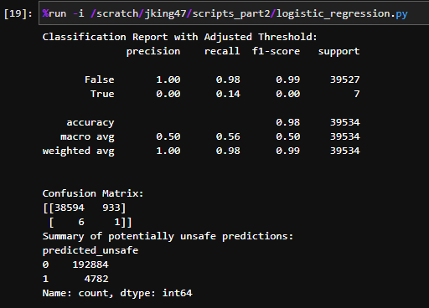
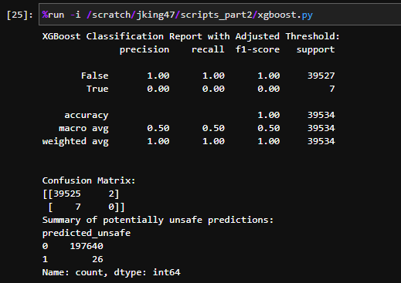
ML REGRESSION MODELS USED
LOGISTIC REGRESSION
XG BOOST
Fig: Performance Metrics of Logistic Regression
Fig: Performance Metrics of XG Boost

Slide 17
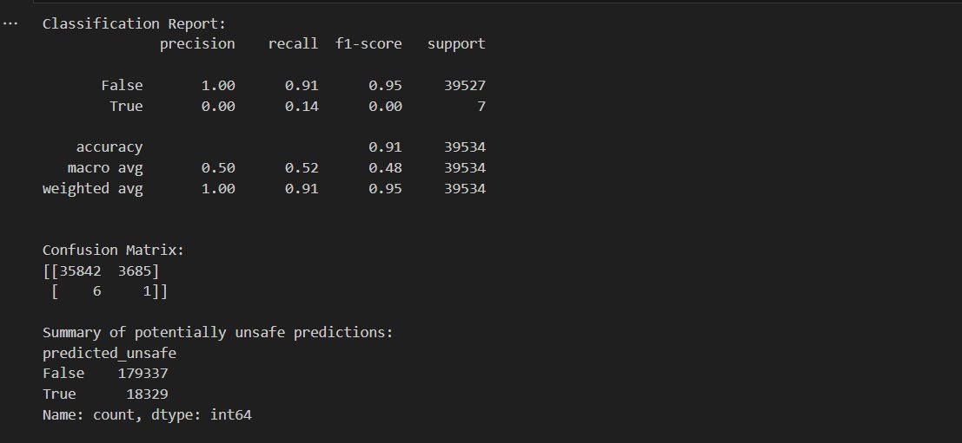
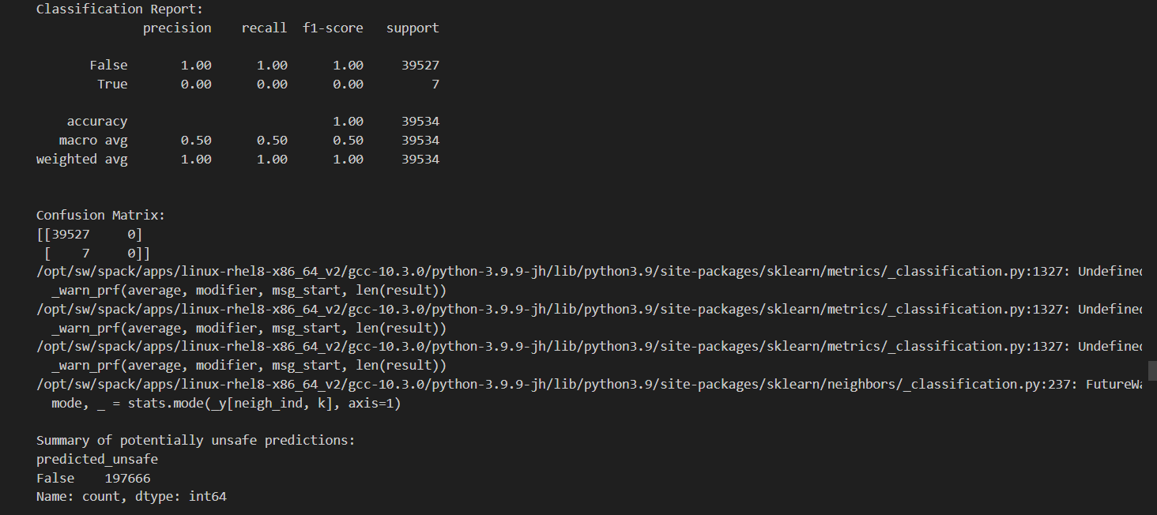
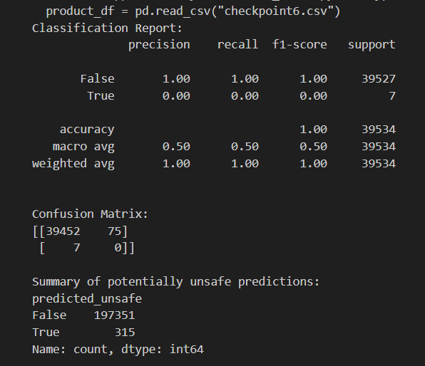
ML REGRESSION MODELS USED
DECISION TREE
K-NEAREST NEIGHBOR
NAÏVE BAYES CLASSIFIER
Fig: Performance Metrics of Decision Tree
Fig: Performance Metrics of K-Nearest Neighbor
Fig: Performance Metrics of Naïve Bayes Classifier

Slide 18
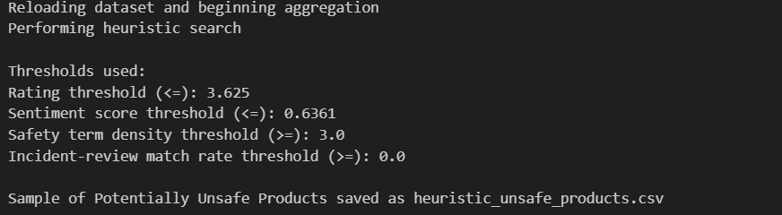
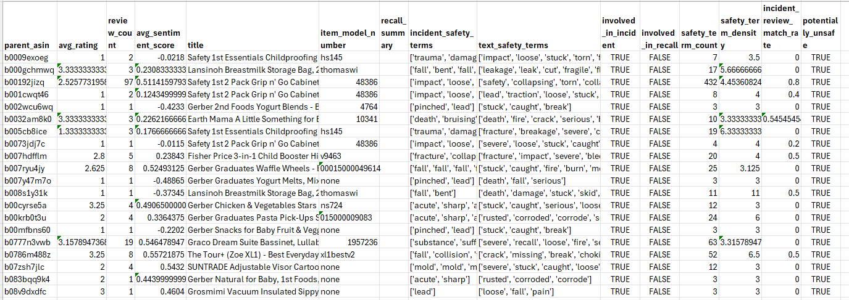
HEURISTIC MODEL
We have performed Feature Engineering with some aggregations to create features.
Since, the merged dataset is not well labelled, we use this features to label the product is potentially safe.
Threshold values use to classify the product as potentially unsafe
Sentiment_threshold < 25 Percentile
Rating_threshold <25 percentile
Safety_term_density > 75 percentile
Incident_review_match_rate >75 percentile
Involved_in_incident = 1

Slide 19
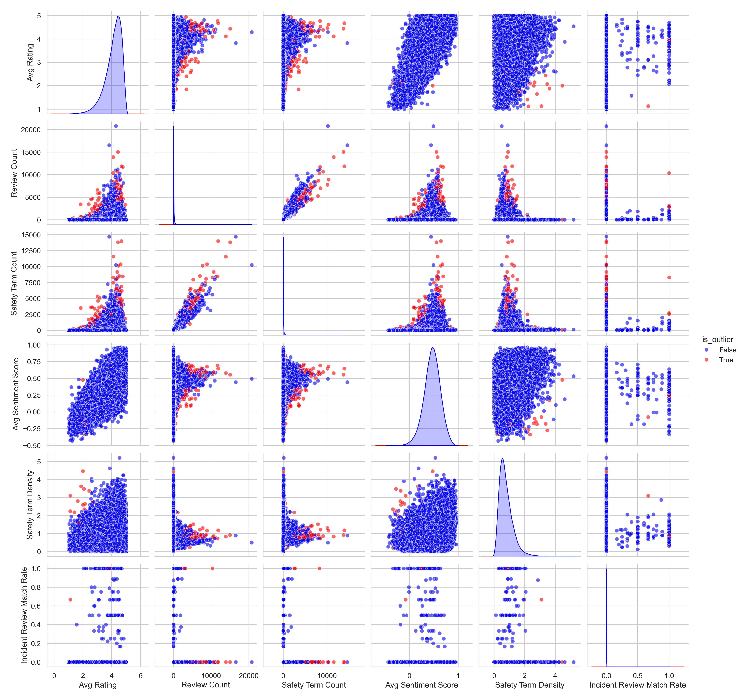
ISOLATION FOREST
Used to detect outliers within a given dimensionality by utilizing random partitioning
Filtered: Products with >15 reviews
Number of Trees: 100
Threshold: .0005
Features chosen (6 dimensions):
Average Rating
Review Count
Safety Term Count
Safety Term Density
Average Sentiment Score
Incident Review Match Rate

Slide 20
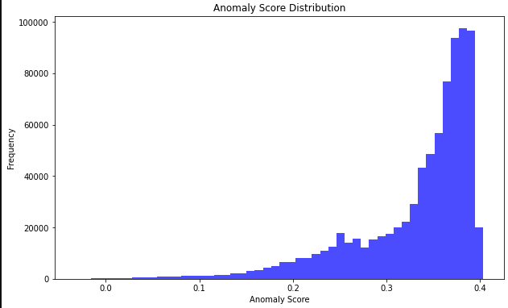
ISOLATION FOREST
Used to detect outliers within a given dimensionality by utilizing random partitioning
Filtered: Products with >15 reviews
Number of Trees: 100
Threshold: .0005

Slide 21
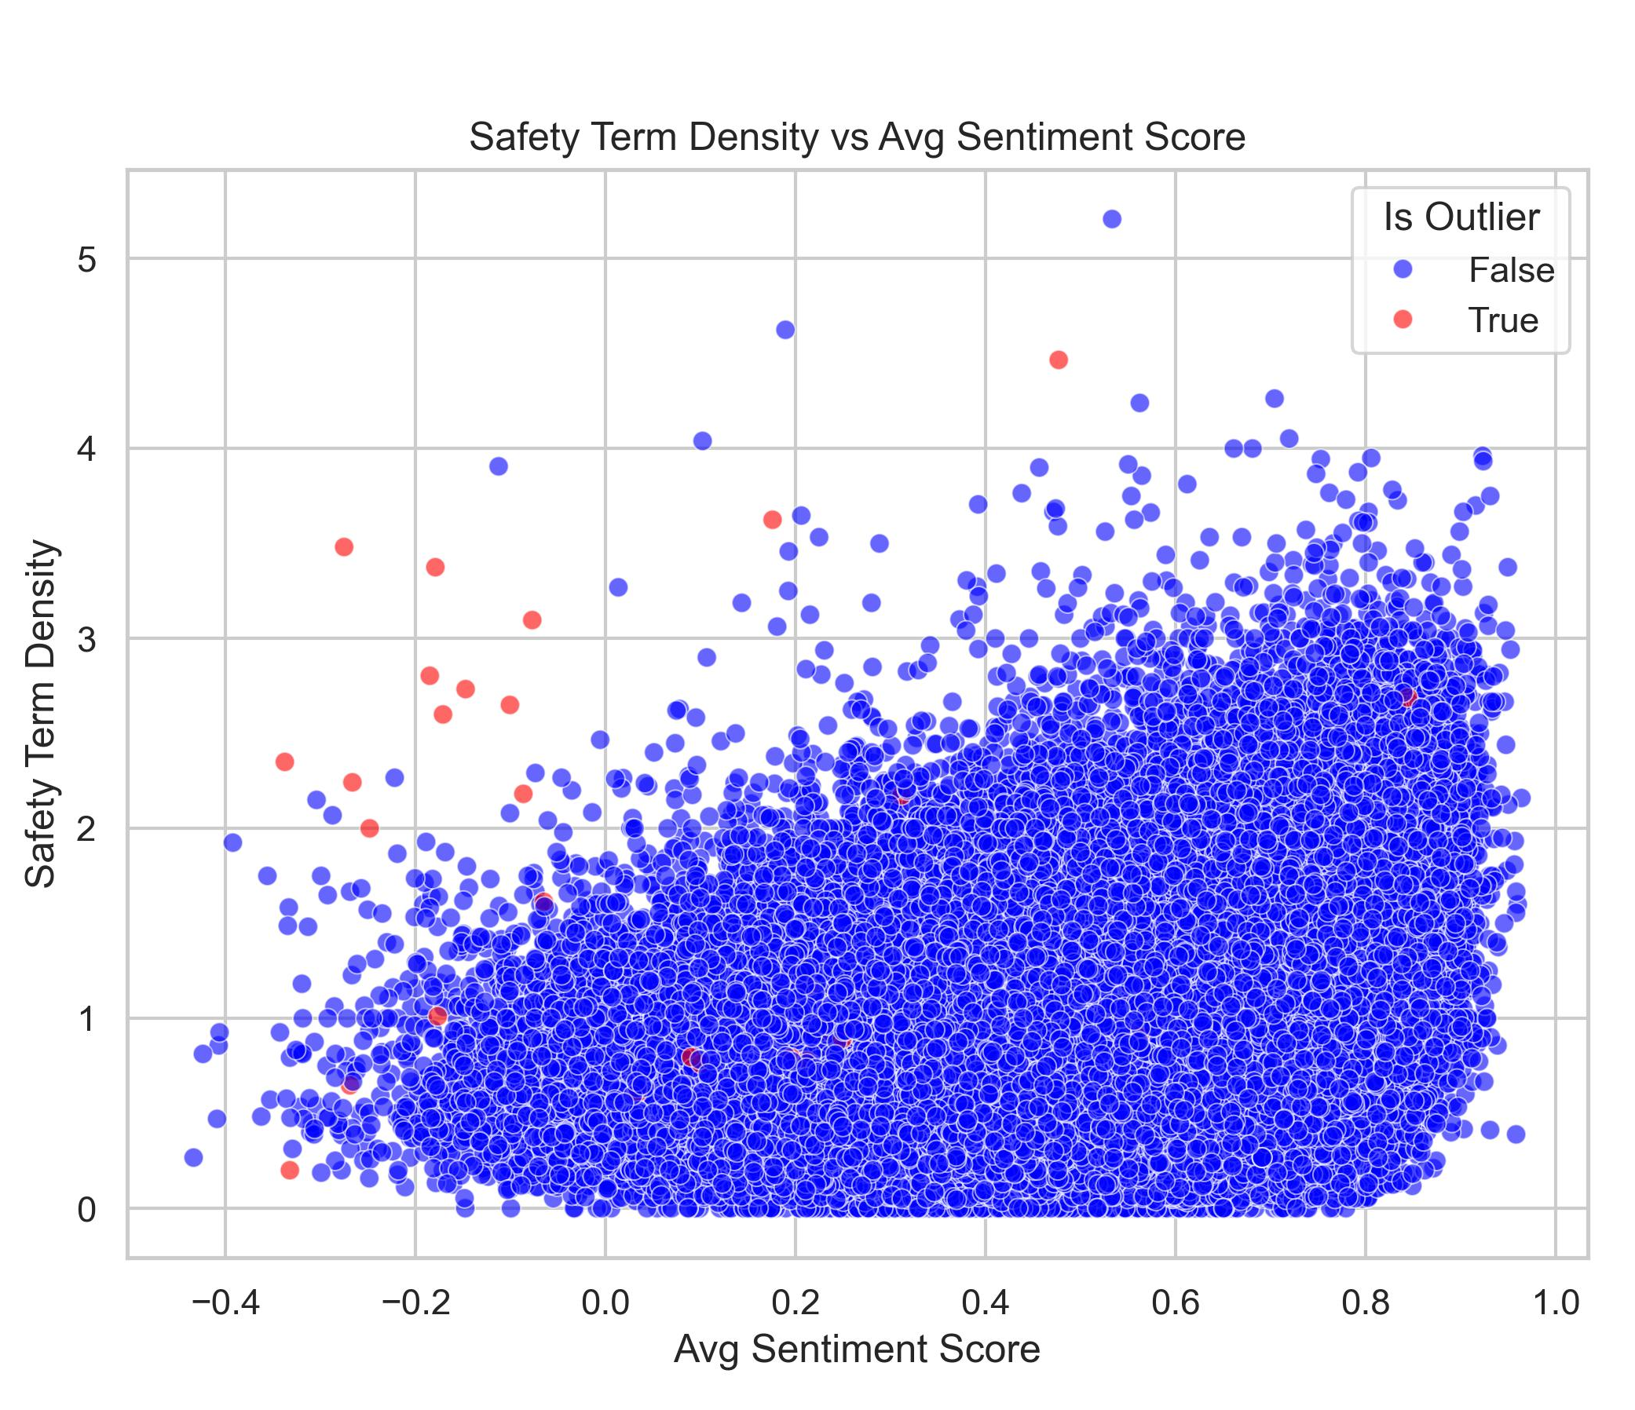
SUMMARY
With some reservations, hypothesis is deemed valid to detect potentially unsafe products using Amazon review data.
Combined approach of sentiment analysis, "dirty word" search, and anomaly detection (or heuristic search)
Methodology limitations:
Limited to flagging for human review
False positive rate ~30%
Unlabeled data
(Processed labelled data deemed unviable/imbalanced)
Non-time series
Relies on aggregation of a manually extracted merged incident dataset

Slide 22
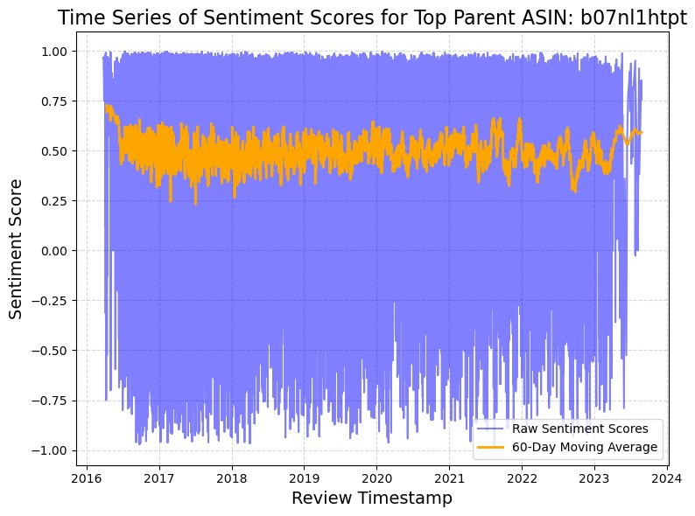
FURTHER AREAS OF STUDY
Supervised Learning
Requires a labeled dataset with appropriate proportionality (1%)
Time Series
Moving average indicator of problems with product
Outside of standard deviations?
Word Matching: Semantic Similarity Scoring
Better than standard "dirty word" searching
Scores word usage intent inside of the parts of speech.
Highly processing intensive

Slide 23
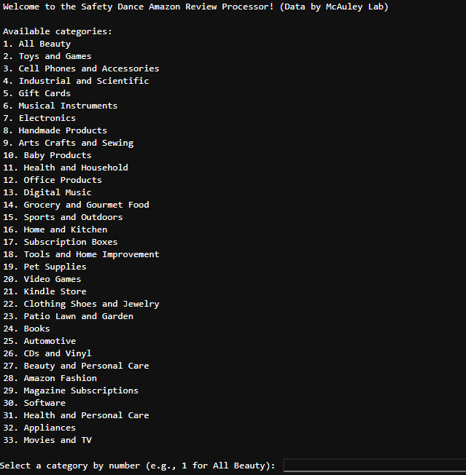
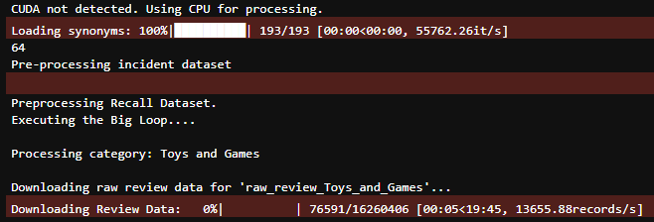
TWO PROCESSING SOLUTIONS
Fig: Single "Big Loop" Function against all categories
Fig: Command Line Interface

Slide 24
STATISTICS:
Number of scripts: 6
Lines of code: 3,252
(1,806 in data conditioning, 1,449 in main loop)
Number of models used/attempted: 15
Datasets processed: 25 out 34
(Other categories were intangibles)
Dataset size: 565mil rows, 337gb
Total time to process: 244 hours
Open-source methodology: 100%
Q&A

Slide 25

THANK YOU

